Slide 1
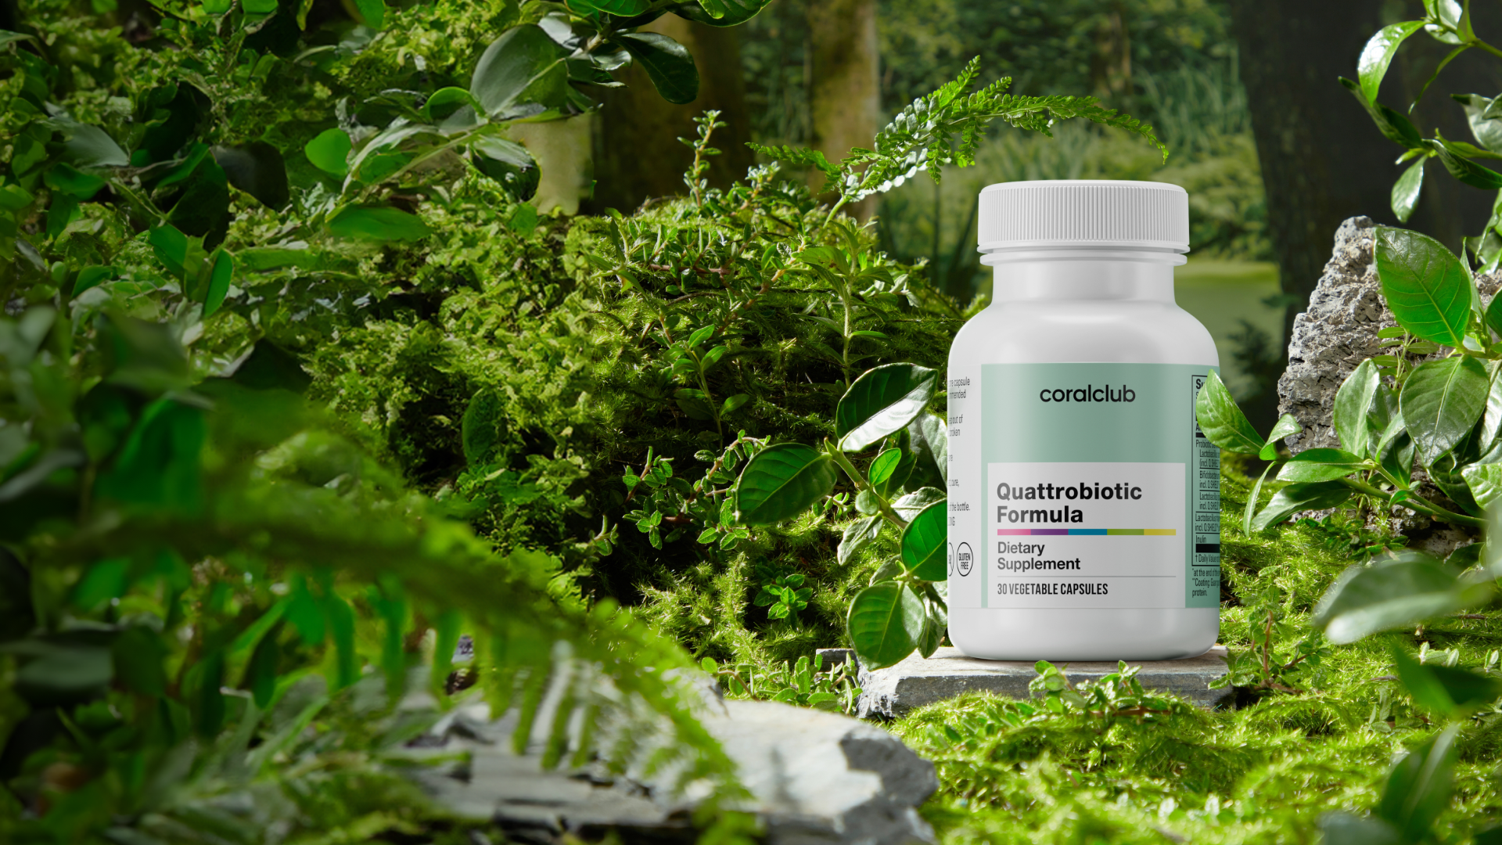
Quattrobiotic
Formula
4 Levels of Intestinal Protection*
*This statement has not been evaluated by the Food and Drug Administration. This product is not intended to diagnose, treat, cure, or prevent any disease.

Slide 2
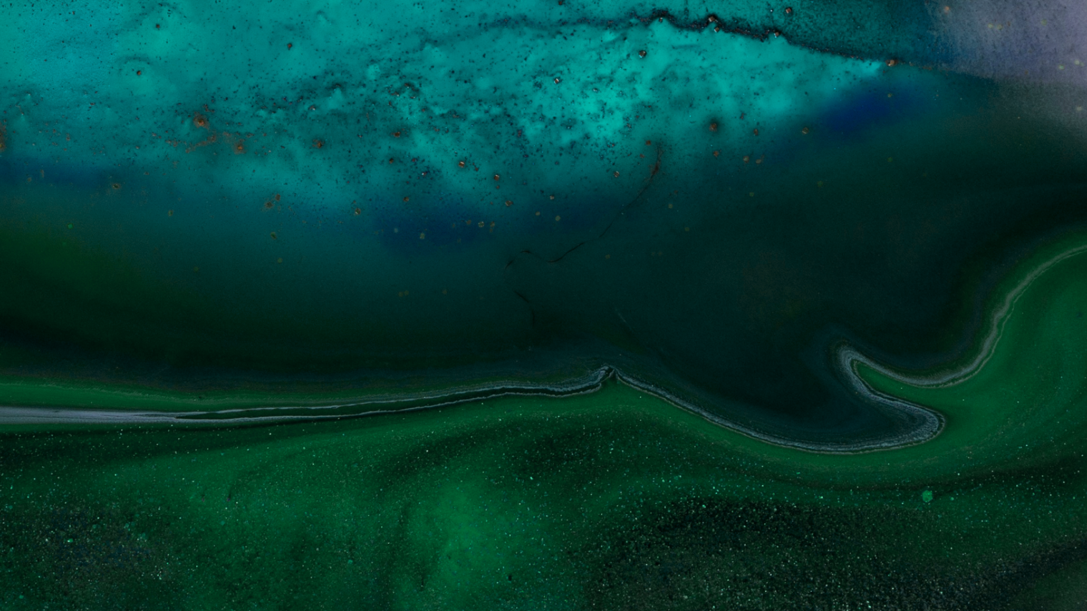
A healthy gut microbiome is the foundation of overall well-being and health
The intestine is the primary immune organ
Barrier function of the intestines
About 70-80% of the body's immune cells are located in the intestines, forming the first line of defense against infections.
Epithelial cells and the intestinal mucosa prevent pathogens and toxins from entering the bloodstream.
Gut microbiota and immunity
Key role in nutrient absorption
The gut microbiota trains the immune system to recognize pathogens and maintain balance, preventing autoimmune diseases.
Helps break down complex carbohydrates and fiber, which the human body cannot digest on its own.

Slide 3
Serotonin Production in the Gut
Approximately 90% of serotonin in the body is produced in the intestines.
It regulates peristalsis (intestinal contractions that aid digestion) and influences inflammation and immune responses.
Serotonin from the gut does not directly enter the brain but can influence the central nervous system through the vagus nerve and other signaling pathways.
Thus, changes in serotonin levels in the gut can affect emotional well-being.

Slide 4
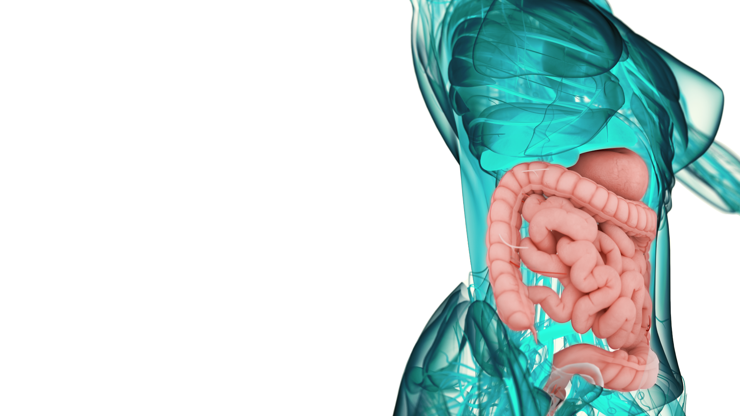
What We Know about the Gut Microbiome
Highly diverse, containing approximately
100 trillion bacteria
~
Comparable in weight to the brain, weighing between
1.2 to 3.5 kg
Found to play an important role in long-living individuals, as it may influence inflammation and support immune system function
Unique to each person, much like a fingerprint—no two microbiomes are identical

Slide 5
Building a Balanced Microbiome Through Lifestyle Choices
Regular Physical Activity
Diverse Diet Rich in Fiber*
Stress Management Skills
Mindful Antibiotic Use
*The food we consume directly influences the composition of the microbiota, which may play a role in mental well-being. Proper nutrition supports overall health, including mental well-being.^{[1]}
"These statements have not been evaluated by the Food and Drug Administration. This product is not intended to diagnose, treat, cure, or prevent any disease."

Slide 6
When we take regular care of ourselves, our microbiome remains in harmony.
A sudden lifestyle change can cause digestive disorders such as:
Diarrhea
Flatulence
Nausea
Unpleasant Taste in the Mouth
Burping
Stomach Pain
Bloating
Loss of Appetite

Slide 7
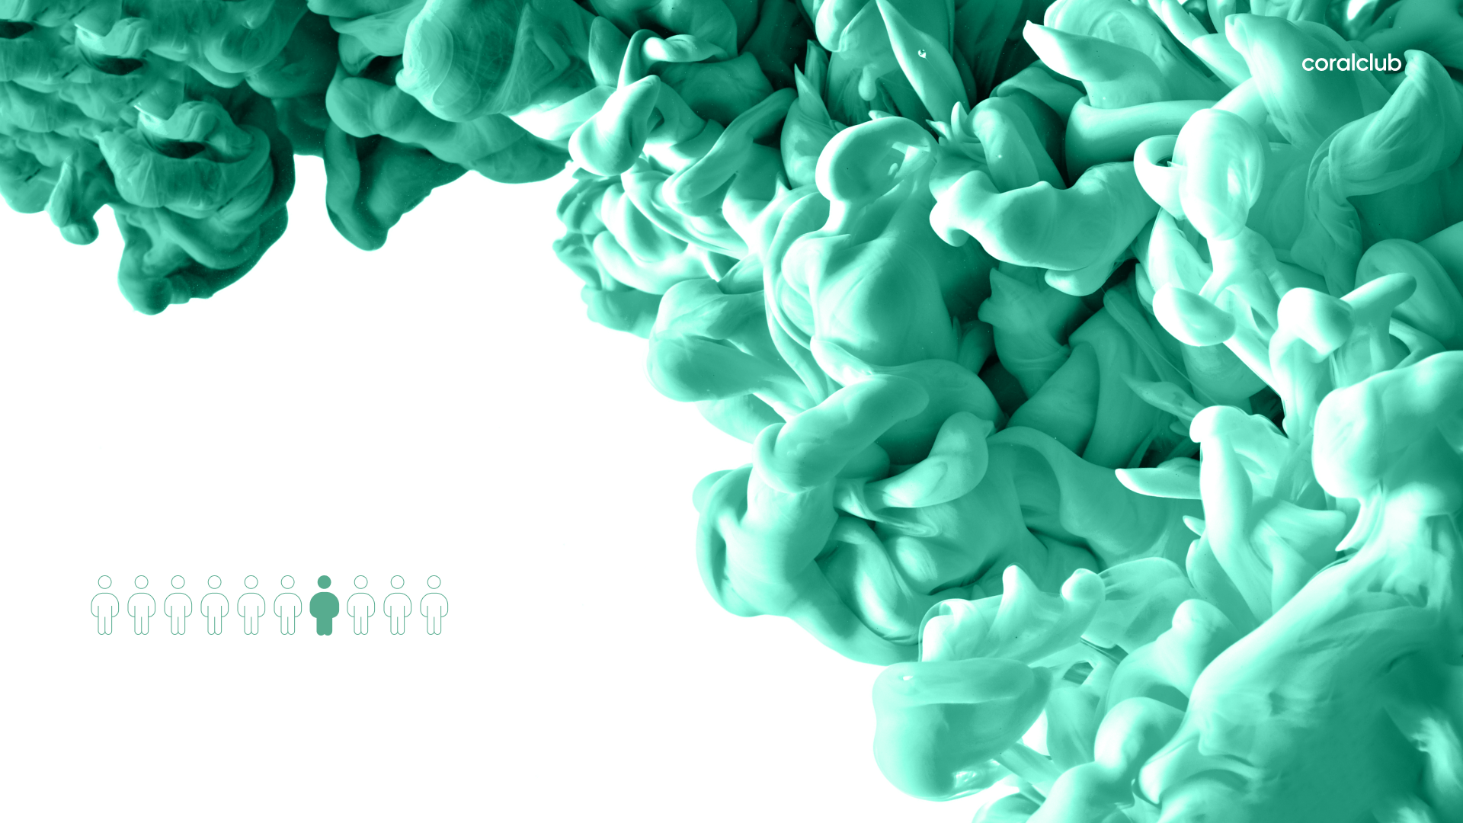
According to global statistics, every tenth person
regularly experiences symptoms
of digestive disorders.^{[2]}

Slide 8
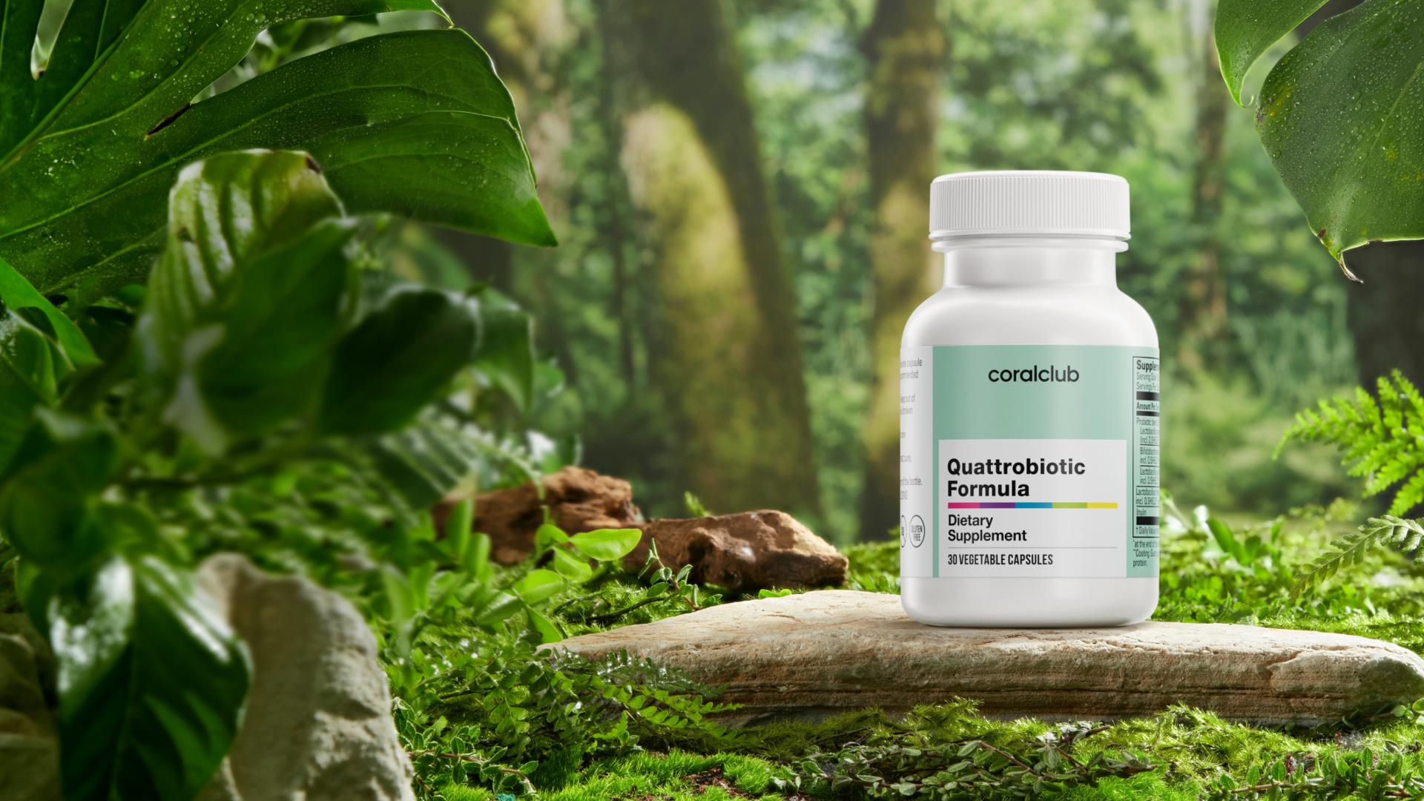
Introducing an innovation in gut microbiome care —
Quattrobiotic Formula*
*This statement has not been evaluated by the Food and Drug Administration. This product is not intended to diagnose, treat, cure, or prevent any disease.

Slide 9
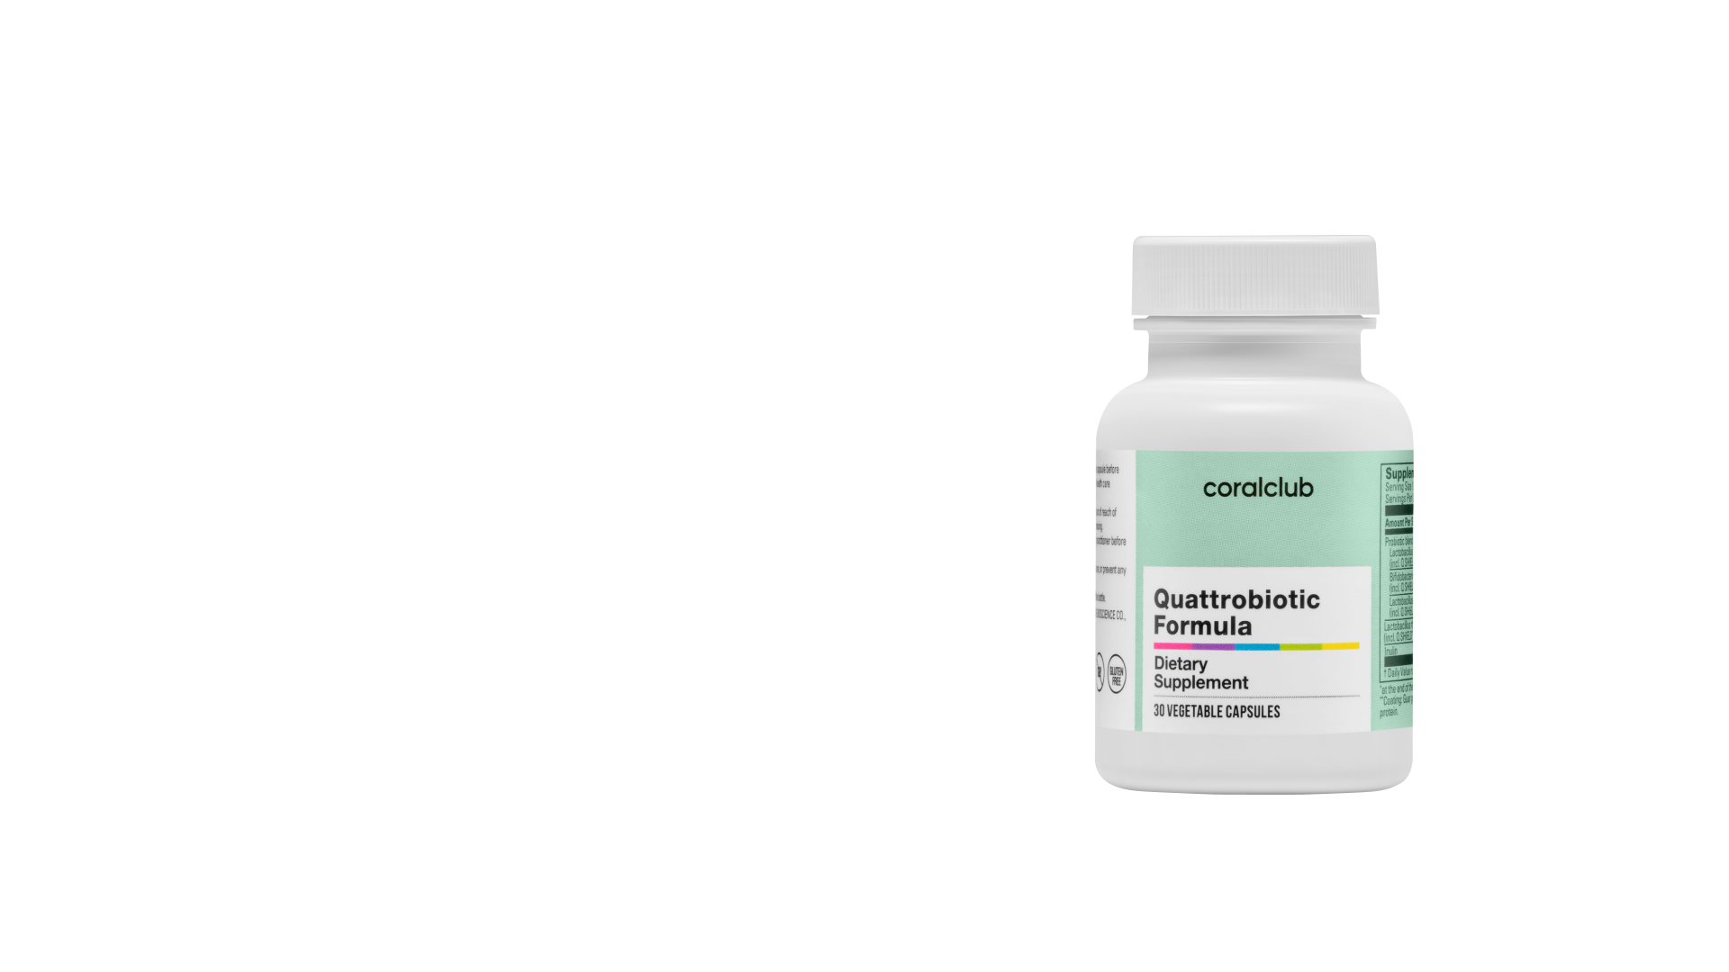
Probiotic + Prebiotic* = Synbiotic
4
types of bacteria
A probiotic blend with clinically studied strains that support gut health and microbiome balance.†
12
billion CFU**
4-layer technology to ensure delivery and protection of microorganisms.†
*Prebiotic ingredient: Inulin from chicory root
**CFU (Colony-Forming Unit) — a measure representing the number of microorganisms in a sample that are capable of reproducing and forming visible colonies.
†These statements have not been evaluated by the Food and Drug Administration. This product is not intended to diagnose, treat, cure, or prevent any disease.

Slide 10
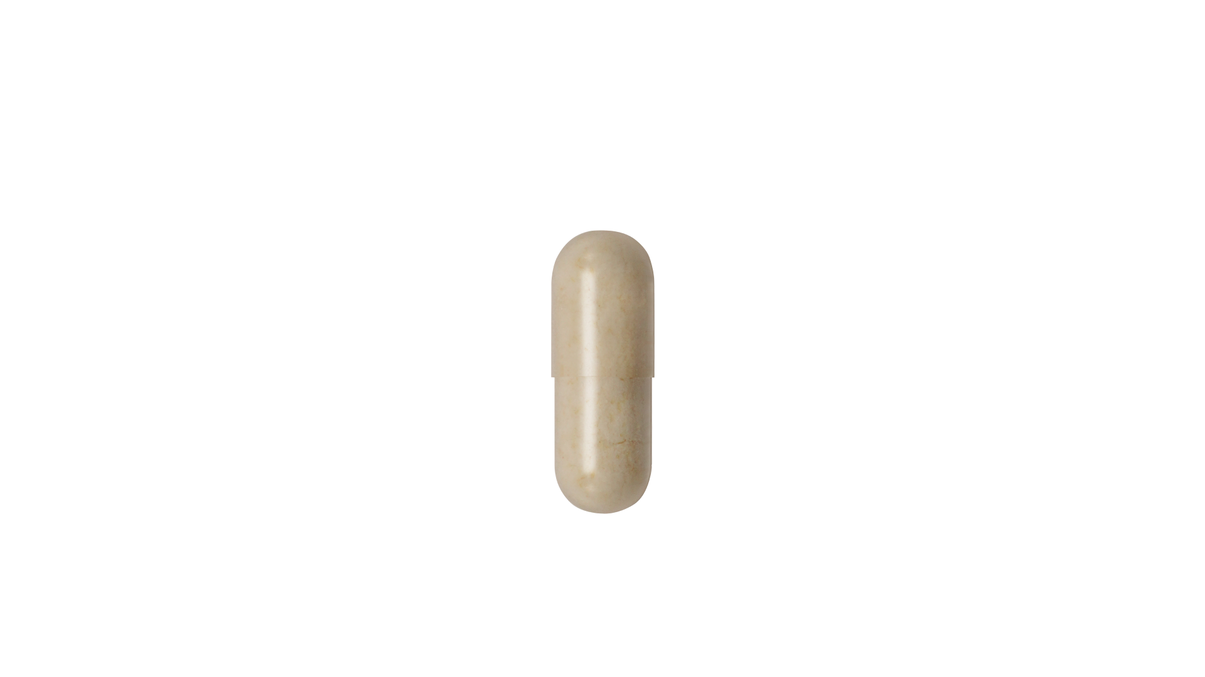
Quattrobiotic Formula
Contains 4 Types of Bacteria
Lactobacillus
johnsonii*
Bifidobacterium
lactis*
Lactobacillus
plantarum*
Lactobacillus
rhamnosus
12 billion CFU
per capsule
*Patent-Protected Probiotic Blend: JPL934™

Slide 11
Patent-Protected Probiotic Blend: JPL934TM
Clinically Proven to Deliver Digestive Health Benefits and Comfort*†
In a double-blind, placebo-controlled clinical study, participants taking the JPL934 blend experienced significant relief of lower gastrointestinal symptoms, including abdominal pain and bloating, after 8 weeks of use. ^{[3]*}†
66.55%
62.71%
61.52%
†
†
Stomach Pain* †
Abdominal Discomfort* †
†Bloating* †
ID-JPL934 group
ID-JPL934 group
ID-JPL934 group
In an in vivo study on mice, the blend demonstrated anti-inflammatory activity and helped reduce colitis-like symptoms ^{[4]} ‡†.
*Results are based on Subjective participant assessments and laboratory analyses; individual experiences may vary.
‡ Findings are based on preclinical research in mice and may not directly affect outcomes in humans.
†These statements have not been evaluated by the Food and Drug Administration. This product is not intended to diagnose, treat, cure, or prevent any disease.

Slide 12
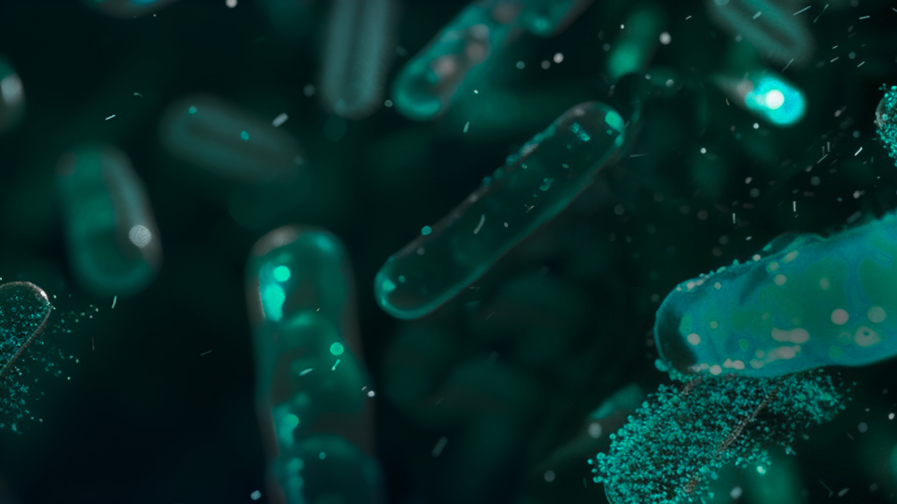
Study on Lactobacillus rhamnosus & Bifidobacterium animalis strains
Supports respiratory health ^{[5]} ‡†
A randomized, double-blind, placebo-controlled study involved 198 participants aged 18-25. Over 12 weeks, one group took the tested bacterial blend in the form of 5 g of powder, containing 1 billion CFU of each bacterial strain, while the other group received a placebo^{[5]}‡†
Findings:
.‡
‡
‡
The duration of upper respiratory tract infections was reduced by
The severity of upper respiratory tract infections was reduced by
33%‡
34% ‡
†These statements have not been evaluated by the Food and Drug Administration. This product is not intended to diagnose, treat, cure, or prevent any disease.
‡This study evaluates specific probiotic strains, Lactobacillus rhamnosus LGG® and Bifidobacterium animalis ssp lactic BB-12®, that are not included in Quattrobiotic. Results may not directly apply to this product.

Slide 13
Study Findings on Lactobacillus plantarum and Bifidobacterium lactis Strains
Studies on these strains show the potential to help reduce LDL “bad” cholesterol levels in the blood, lowering the risk of cardiovascular disease.‡†
Research on L. plantarum and B. lactis strains has shown potential benefits for heart health†
Bifidobacterium lactis
Lactobacillus plantarum
A randomized, blinded, placebo-controlled study involving 51 participants diagnosed with metabolic syndrome, aged 18-60 years.^{[6]} ‡
A randomized, placebo-controlled study involving 49 participants with varying degrees
of hypercholesterolemia, aged 30-65 years^{[7]} ‡
128.5
120
4.27
111.0
4
3.87
100
Start of the study
Low-Density Lipoprotein (LDL) levels, mmol/L
Start of the study
Low-Density Lipoprotein (LDL) levels, mg/dL
45 days after the start of the study
6 weeks after the start of the study
0
0
†These statements have not been evaluated by the Food and Drug Administration. This product is not intended to diagnose, treat, cure, or prevent any disease.
‡ The specific strains evaluated in these studies were Lactobacillus plantarum ECGC 13110402 and Bifidobacterium lactis HN019, which differ in strain numbers from the strains used in Quattrobiotic. Results may not directly apply to this product.

Slide 14
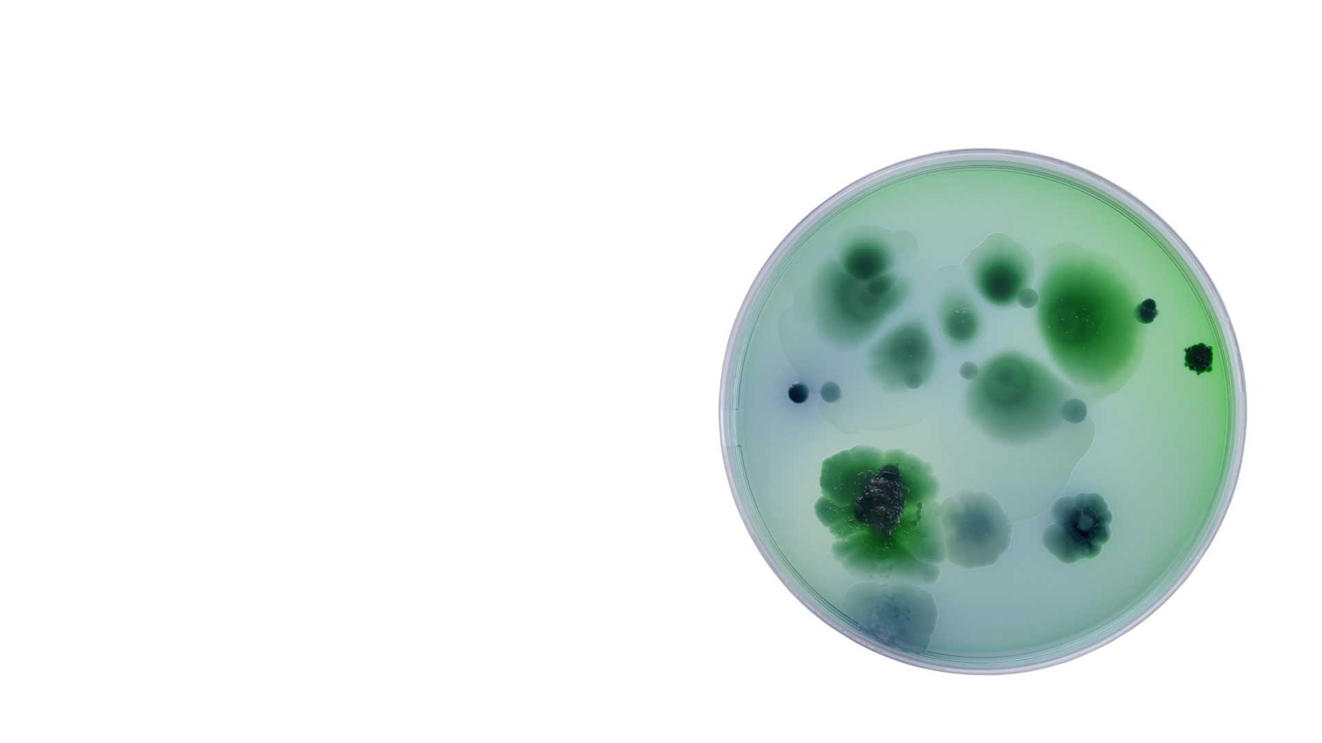
Triple Action of Lactobacillus rhamnosus
Promotes Intestinal Health†
Supports the renewal of intestinal tissue and helps restore gut function.
Balances Inflammatory Response*†
Supports a healthy inflammatory response, enhances immune function, and supports the body’s natural defenses. ^{[8]}
Protects the Gut†
Creates a shield in the gut by enhancing the mucosal layer to protect against harmful microbes.
† These statements have not been evaluated by the Food and Drug Administration. This product is not intended to diagnose, treat, cure, or prevent any disease.
*Based on a referenced study(8)

Slide 15
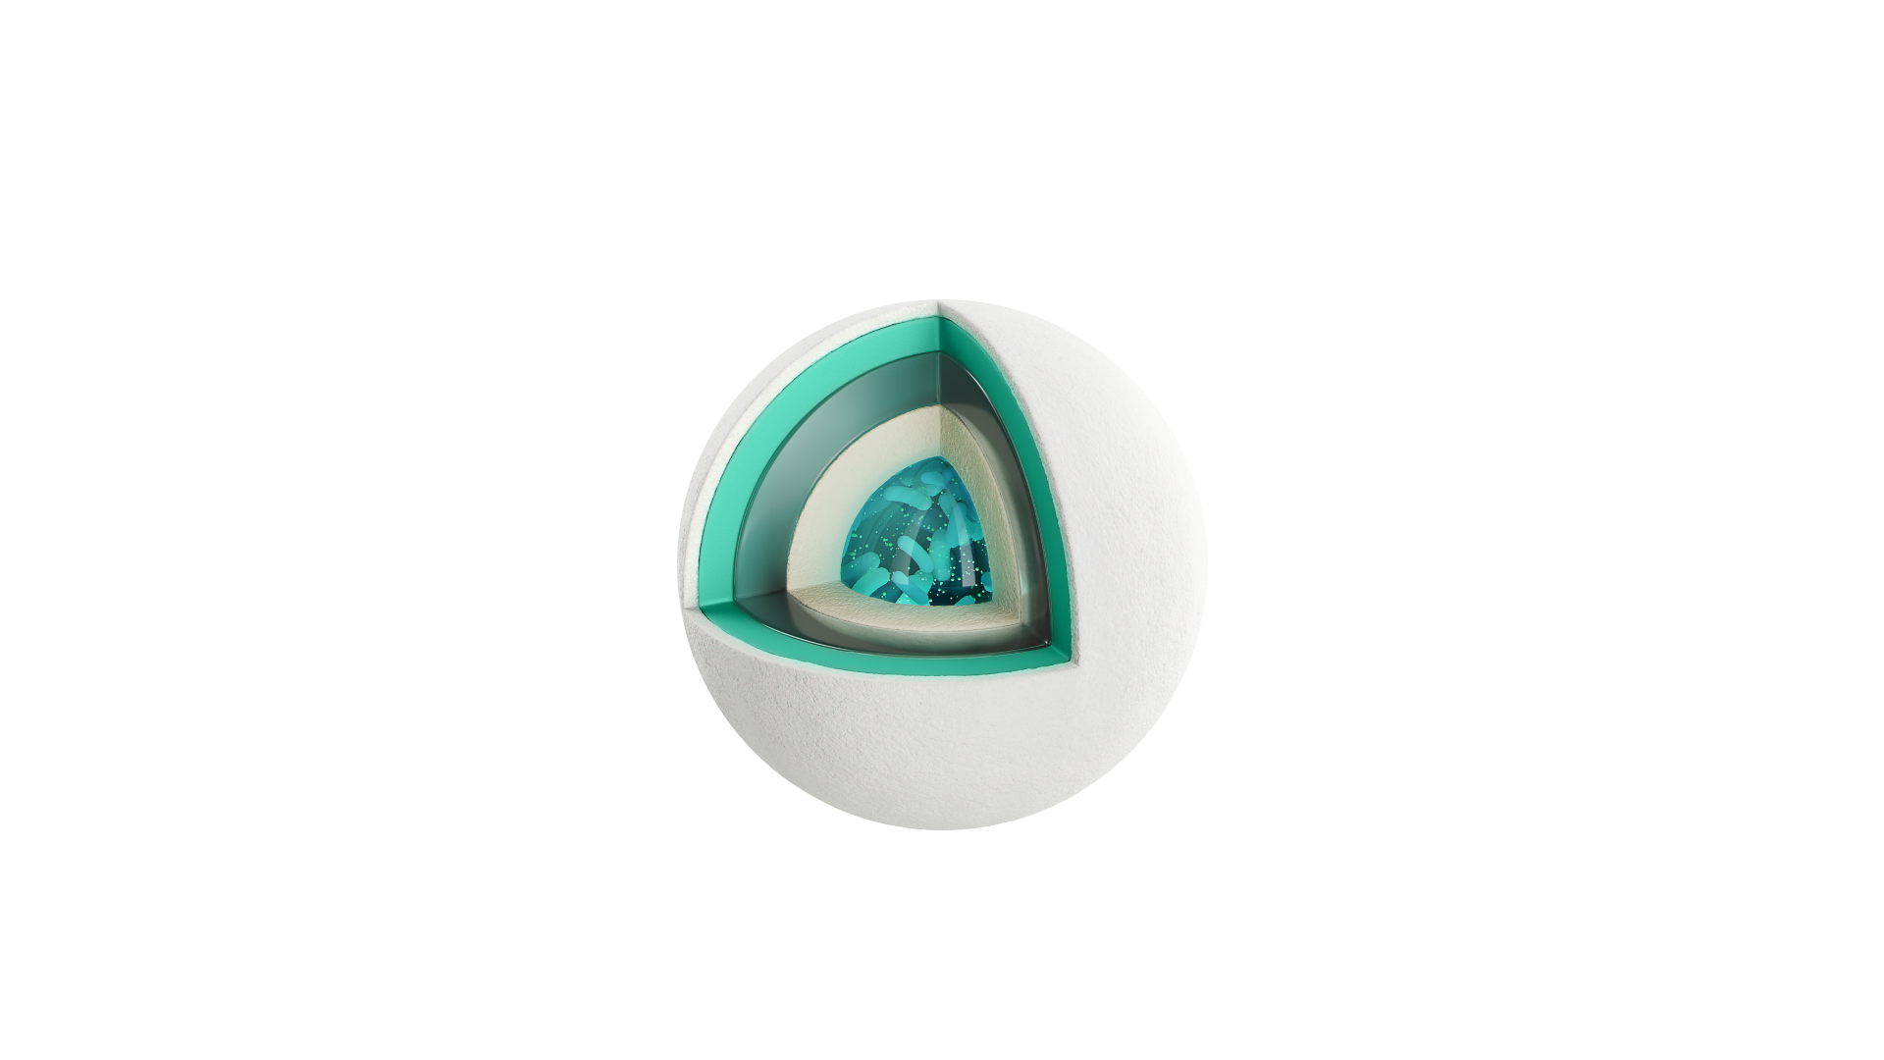
Advanced 4-Layer Probiotic Delivery Technology
1
2
Protect against air exposure
Protects against moisture
4
3
Protects against bile acids
Supports survival in stomach acid
This advanced 4-layer technology is designed to safeguard probiotics from stomach acid, maximizing their survival and enhancing their delivery to the intestines for optimal effectiveness.

Slide 16
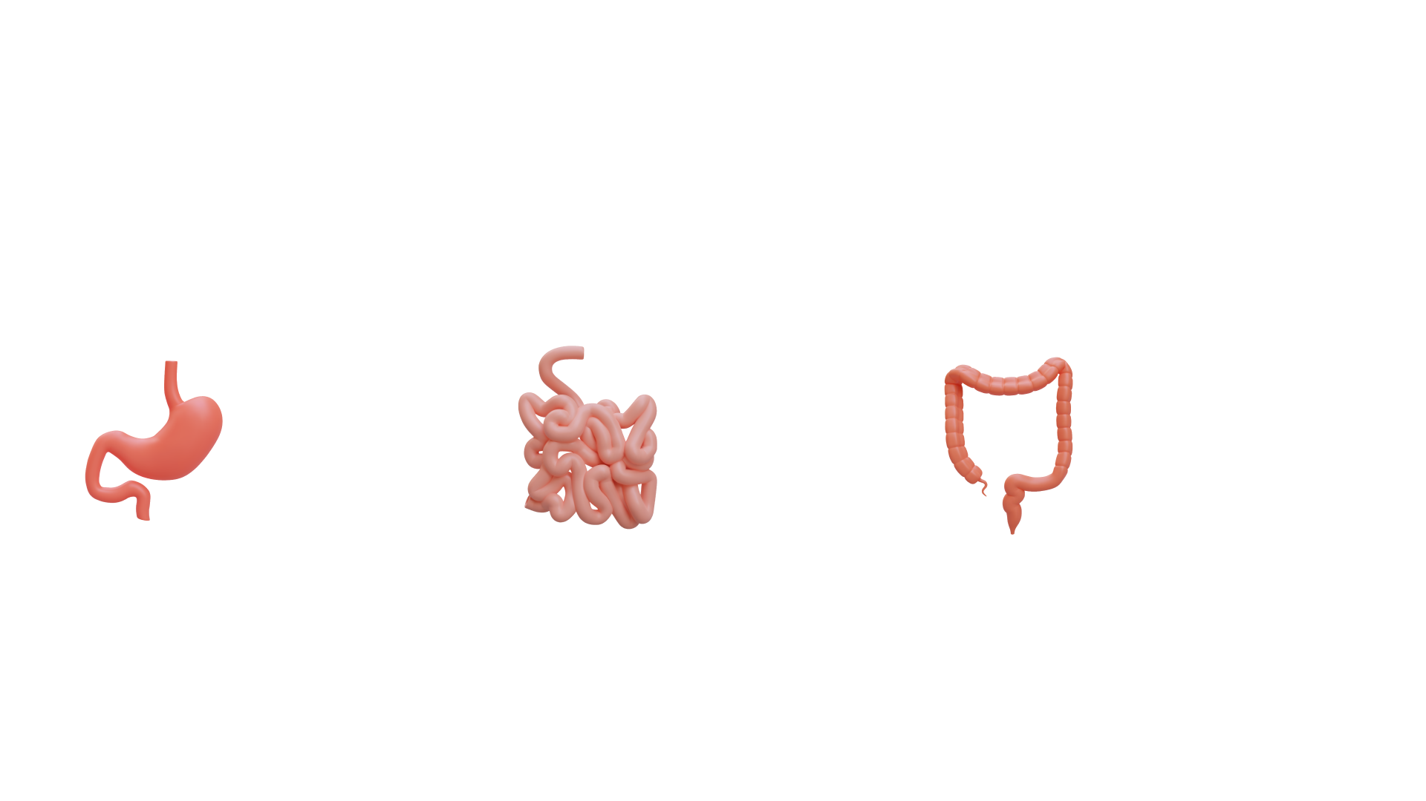
Probiotics with 4-Layer Coating Have Significantly Higher Survival Rates*†
In the stomach
In the small intestine
In the large intestine
L. rhamnosus > 2.11x higher survival*†
B. lactis > 2.56 x higher survival*†
L. rhamnosus > 5.19 x higher survival*†
B. lactis > 6.54 x higher survival*†
L. rhamnosus > 10.97 higher survival*†
B. lactis > 14.97 higher survival*†
*According to the internal study conducted by the manufacturing company. Results may vary.
†These statements have not been evaluated by the Food and Drug Administration. This product is not intended to diagnose, treat, cure, or prevent any disease.

Slide 17
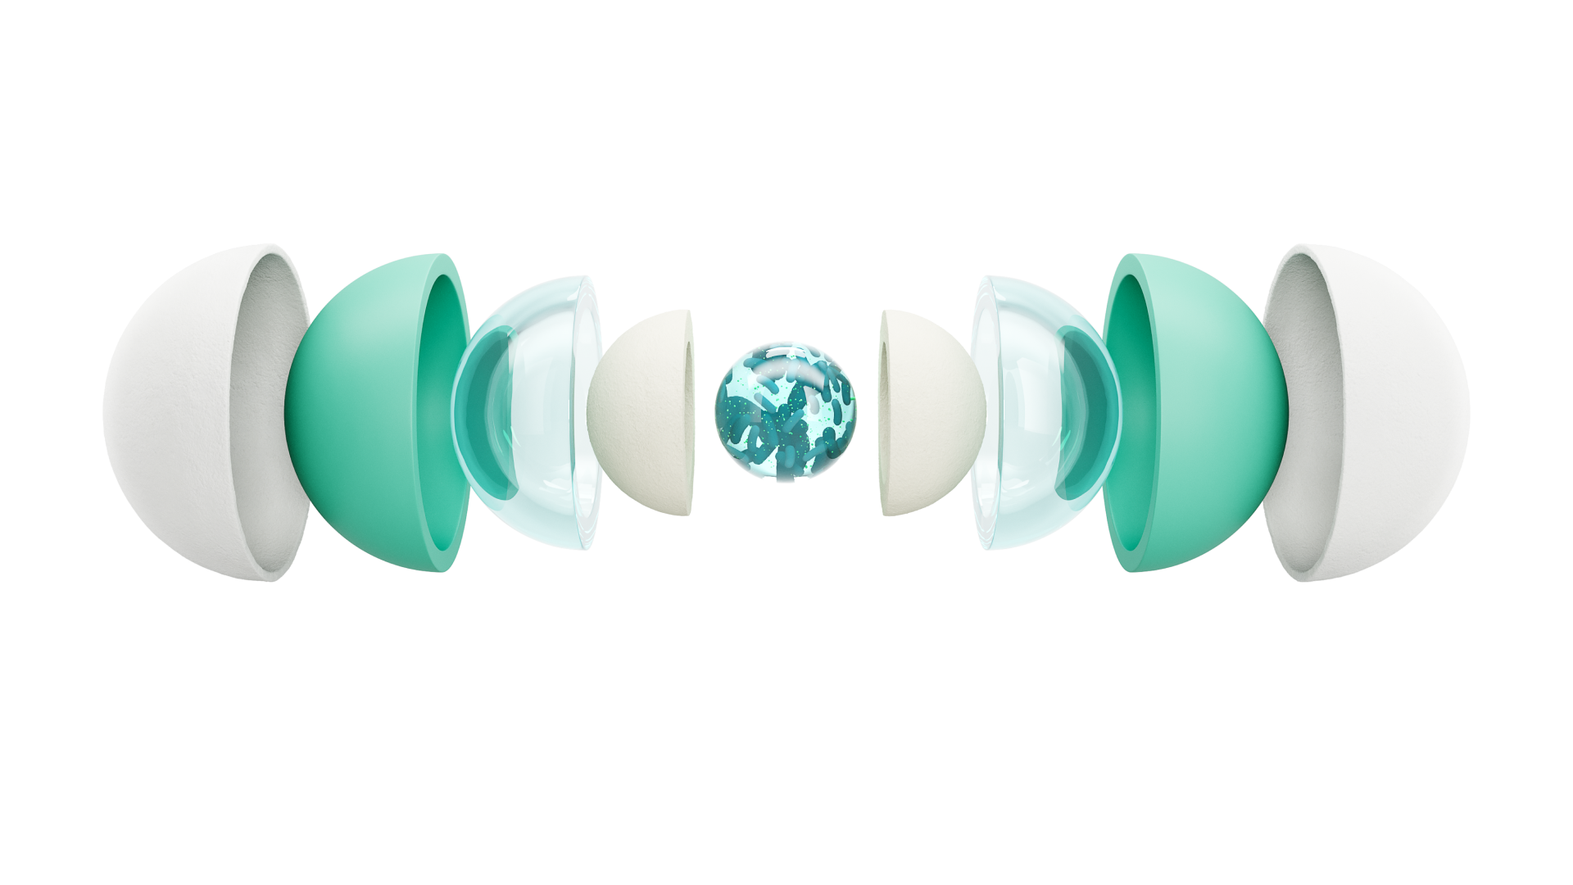
4-Layer Coating
Designed to:
Protection from external factors
Stability in the body’s internal environment
Targeted delivery of active ingredients
Easy storage and portability

Slide 18
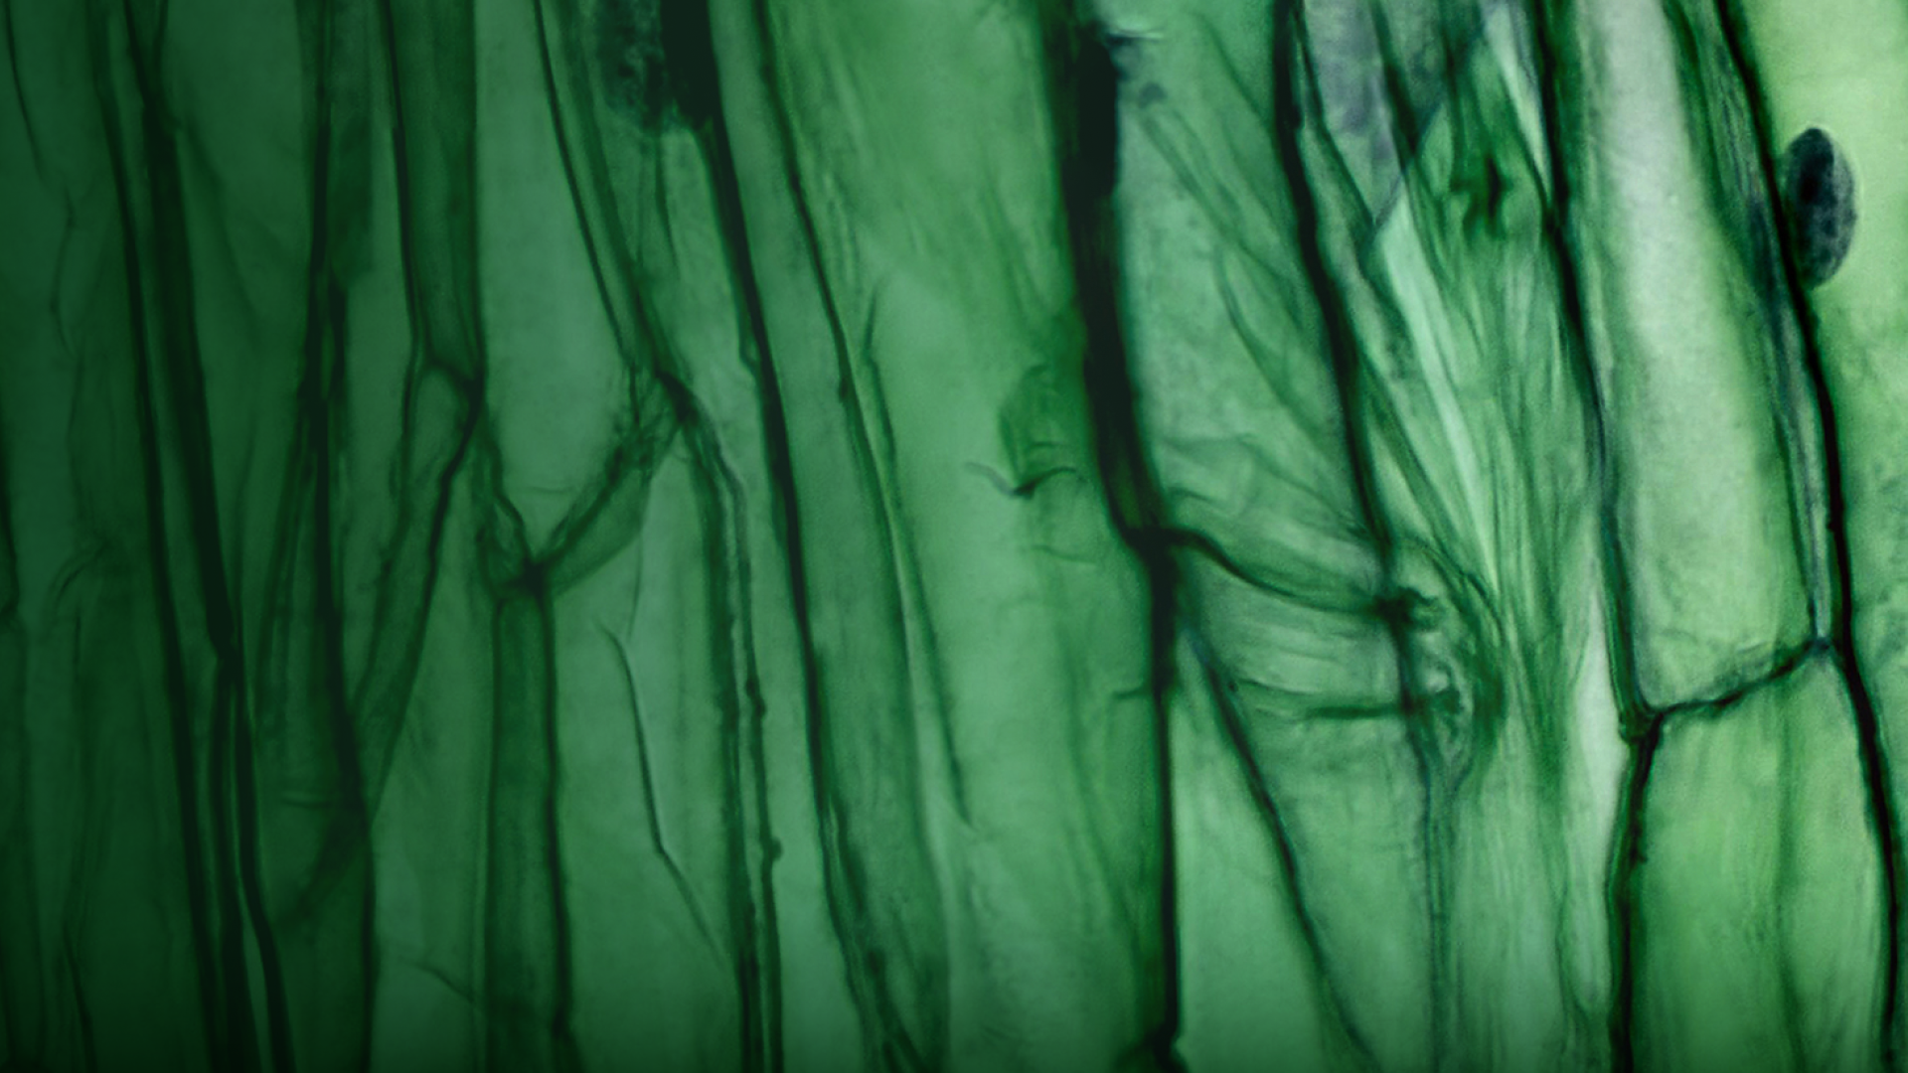
Also included in Quattrobiotic Formula
Prebiotic: Chicory Root Inulin
A polysaccharide widely found in nature. Many plants, such as chicory, dandelion, and Jerusalem artichoke, store it as an energy reserve. It is widely used in the food industry to enhance flavor and texture.
The human body lacks the enzymes to digest inulin, yet it serves as nutrition for gut microbiota.
Inulin helps:
Helps support healthy glucose levels and cholesterol balance^{[10]} *†
May help reduce cravings for sweet and salty foods when used as part of a balanced diet (^{9,10]} *†
May help increase the population of beneficial bacteria in the gut^{[9,10]} *†
†These statements have not been evaluated by the Food and Drug Administration. This product is not intended to diagnose, treat, cure, or prevent any disease.
*Based on studies of inulin’s properties. Individual results may vary.

Slide 19
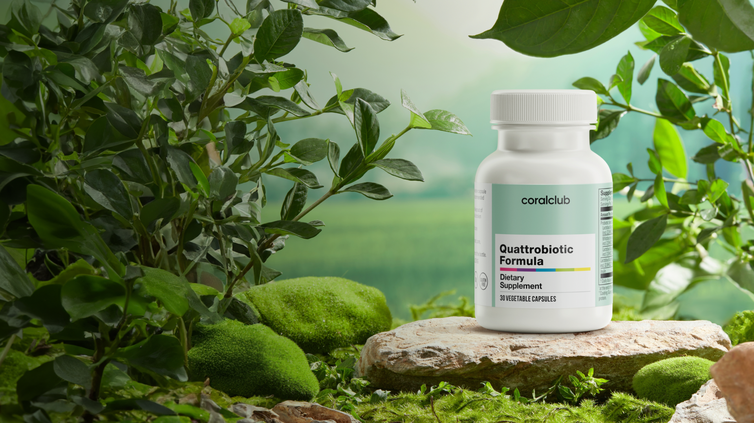
Quattrobiotic Formula
Helps:
Aids digestion and nutrient absorption†
Support balanced intestinal function†
Support a healthy immune response†
†These statements have not been evaluated by the Food and Drug Administration. This product is not intended to diagnose, treat, cure, or prevent any disease.

Slide 20
Quattrobiotic
Formula
High concentration
12
billion CFU
Clinically proven effectiveness† – patented JPL934TM blend of 3 strains†
per capsule
4 levels of intestinal protection†
A new level
of gut microbiome care †
4-layer coating – an innovative probiotic delivery technology
†These statements have not been evaluated by the Food and Drug Administration. This product is not intended to diagnose, treat, cure, or prevent any disease.

Slide 21
Sources
1. Anderson S. C., Cryan J. F., Dinan T. The psychobiotic revolution: mood, food, and the new science of the gut-brain connection. – National Geographic Books, 2017.
2. Sperber A. D. et al. Worldwide prevalence and burden of functional gastrointestinal disorders, results of Rome Foundation Global Study //Gastroenterology. – 2021. – Т. 160. – №. 1. – С. 99-114. e3.
3. Shin C. M. et al. Validity and safety of ID-JPL934 in lower gastrointestinal symptom improvement //Scientific reports. – 2021. – Т. 11. – №. 1. – С. 13046.
4. Je I. G. et al. The probiotic, ID-JPL934, attenuates dextran sulfate sodium-induced colitis in mice through inhibition of proinflammatory cytokines expression //Journal of medicinal food. – 2018. – Т. 21. – №. 9. – С. 858-865.
5. Smith T. J. et al. Effect of Lactobacillus rhamnosus LGG® and Bifidobacterium animalis ssp. lactis BB-12® on health-related quality of life in college students affected by upper respiratory infections //British journal of nutrition. – 2013. – Т. 109. – №. 11. – С. 1999-2007.
6. Costabile A. et al. An in vivo assessment of the cholesterol-lowering efficacy of Lactobacillus plantarum ECGC 13110402 in normal to mildly hypercholesterolaemic adults //PloS one. – 2017. – Т. 12. – №. 12. – С. e0187964.

Slide 22
7. Bernini L. J. et al. Beneficial effects of Bifidobacterium lactis on lipid profile and cytokines in patients with metabolic syndrome: A randomized trial. Effects of probiotics on metabolic syndrome //Nutrition. – 2016. – Т. 32. – №. 6. – С. 716-719.
8. 7 Things Lacticaseibacillus rhamnosus Is Good For // internationalprobiotics URL: https://internationalprobiotics.org/
9. Hiel S. et al. Effects of a diet based on inulin-rich vegetables on gut health and nutritional behavior in healthy humans //The American journal of clinical nutrition. – 2019. – Т. 109. – №. 6. – С. 1683-1695.
10. Teferra T. F. Possible actions of inulin as prebiotic polysaccharide: A review //Food Frontiers. – 2021. – Т. 2. – №. 4. – С. 407-416.

