Slide 1
Immunity Pack
maximum immunity protection
Notes:
1

Slide 2
How good is your immune function?
Strength of your immune function isa result of your lifestyle
^{Weakened} ^{Immune System}
^{Strong Immune System}
Signs:
You exhibit signs of illness more often
Your wounds heal much slower
Your stress levels are much higher than normal
Signs:
You are ill less frequently
You recover from illness faster than usual
You have a higher level of energy throughout the day
Notes:
Few can boast of having strong immunity. For the vast majority, our immunity is the result of daily choices, our lifestyle.
Immunity reflects the general state of health- the stronger the health, the better the immunity. Everything that strengthens health, strengthens the immune system: having good amounts of sleep, regular exercise, healthy diet etc

Slide 3
What weakens your immune system
Bad habits
Junk food
stress
Sleep habits
age
Slow recover from injury
disease
Allergies and intolerances
Notes:
A sharp decrease in immunity often occurs during stress and/or heavy exertion of the body. Therefore, the risk group includes people whose professions are very stressful and exhausting.
People who, due to the specifics of their work, have unreliable sleeping patterns, exercise and eating habits are particularly vulnerable to immunity issues.
Elderly people are also at risk, as aging leads to a progressive decline in multiple physiological processes, including immune responses, so the immune system weakens with age.
Of course, those with inherent or chronic health issues are very much at risk as well.

Slide 4
Signs of weakened immune system
Increased fatigue
Irritability, anxiousness, Sad mood
Skin problems
Minor illnesses have a higher impact
Higher Frequency of getting sick
Repeated infections
Notes:
Assess yourself

Slide 5
What is an immune system?
Immune system is our body's defense against infections.
It helps protect us from:
viruses
bacteria
microscopic fungi
IMMUNE SYSTEM
Notes:
Everyone knows about the need to maintain immunity, but when asked "what is immunity?" a lot of people will shrug their shoulders.
Immunity (from Latin immunitas – freedom, exemption) is a biological system of the body's defense against external and internal biologically active agents (antigens *). It is aimed at maintaining the stability of the internal environment (homeostasis) of the body.
* Antigens - the general name of agents and substances foreign to the body. They can be waste products of microorganisms - pathogens of various diseases, poisonous compounds of plant and animal origin, dead or degenerated cells of the organism itself and other substances.

Slide 6
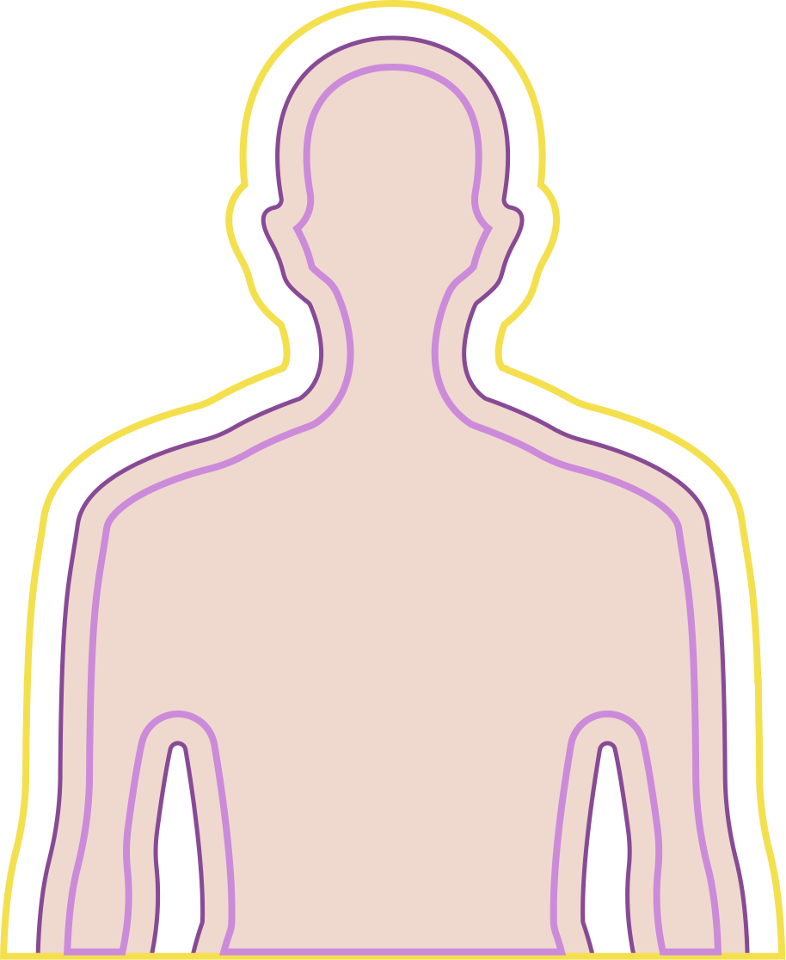
Immune system protects
Internally and
externally
The immune system not only fights against external threats to your health, but also repairs the body's cells and molecules when damaged.
It can even recognize damaged DNA

Slide 7
Where are immunal cells
developed
T- and B-Lymphocytes are white blood cells which are critical to the immune system. These cells are created in our bone marrow, making it a vital part of our immune system. They are also significantly present in the Thymus.
THE FOLLOWING ARE ALL A PART OF OUR IMMUNE SYSTEMS:
Tonsils
Lymph nodes, Lymphoid tissue
The skin is a vital part of our body to keep out external threats.
Spleen
Appendix
Notes:
Parts of the immune system:
1. Specific organs responsible for the production and training of immune cells:
Central organs (red bone marrow and thymus) are the birthplace of all cells, including the most important cells T and B lymphocytes, which help the immune system “learn”.
Peripheral organs (lymph nodes, lymphoid tissue, tonsils, spleen, appendix) - the place of localization of "trained" cells for the implementation of immune supervision and "training" of other cells of the immune system.
2. Individual cells of the immune system (macrophages, lymphocytes) located in the blood and circulating with it throughout the body.
3. Blood and lymphs, which combine all components of the immune system into a single whole and ensure their movement.

Slide 8
hierarchy of immunity
Innate (Inherited) Immunity: the automatic responses and defenses
Adaptive (acquired) Immunity: learns from threats
Barriers: Skin, mucous membranes, enzymes, gastric juice. They are surface barriers (mechanical, biological, chemical).
Cells: phagocytes (macrophages, neutrophils, and dendritic cells), innate lymphoid cells, mast cells, eosinophils, basophils are all microscopic allies in the defense of your body!
T- and B-lymphocytes
They recognize and remember foreign threats and provide an intense targeted response
Notes:
Nonspecific (innate, maladaptive) immunity is the same type of reaction of the body to any foreign antigens.
Congenital immunity is provided by:
• External protective parts of the body, mucous membranes of the respiratory tract, digestive tract, blood vessel walls. Their integrity prevents pathogenic organisms from entering the body.
• A large amount of biologically active substances (the enzyme of saliva lysozyme, protective blood proteins, etc.). They are a chemical or biological barrier to pathogens entering the body.
• Certain types of leukocytes capable of phagocytosis (phagocytosis - (Greek φαγεῖν "devour" + κύτος "cell"), the process by which cells (specially designed blood cells and body tissues - phagocytes) capture and digest solid particles with a diameter of more than 0.1 microns, including bacteria and large molecular complexes). The cells of innate immunity include: phagocytes (macrophages, monocytes, neutrophils, dendritic cells, mast cells), basophils, eosinophils, epithelial cells, endothelial cells, NK cells.
If the substance is molecularly dispersed (for example, protein, polysaccharide, virus), non-toxic and does not have physiological activity, it cannot be neutralized and excreted by the body according to the above scheme (be captured and digested). In this case, a specific (adaptive, acquired) immunity is triggered. It is acquired as a result of the body's contact with the antigen and is characterized by the formation of immunological memory. Cellular carriers of acquired immunity are lymphocytes (T- and B-lymphocytes). Acquired (specific) immunity, in contrast to congenital, is formed throughout a person's life. It can occur after a disease (active natural) or after vaccination (active artificial).

Slide 9
There is always work for
the immune system
In one cubic meter of air, a room can contain 1,500-7,000 and even more microorganisms
(depending on the season).
7 000

Slide 10
Manage your defenses
external
internal
Sleep well
Eat healty
Exercise regularly
Taking nutrients and vitamins
Avoid bad habits
Treat chronic diseases
Notes:
What can be done to strengthen immunity right now? Start doing what you can do for nutritional support with the new Coral Club Pack!

Slide 11
Immunity pack
Strengthens protection
Activates immunity
Helps Speed up recovery
These statements have not been evaluated by the Food and Drug Administration. This product is not intended to diagnose, treat, cure, or prevent any disease.

Slide 12
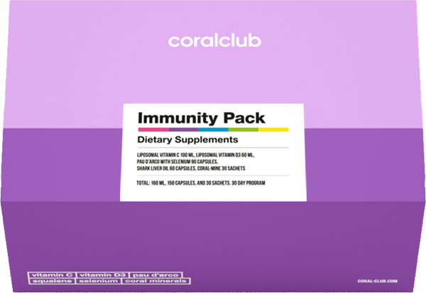
Immunity pack
A Set to Help strengthen your immune system
30 day course
Contains 5 products
Full of vitamins, phytonutrients and minerals

Slide 13
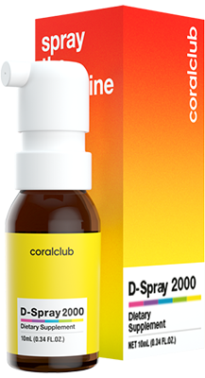
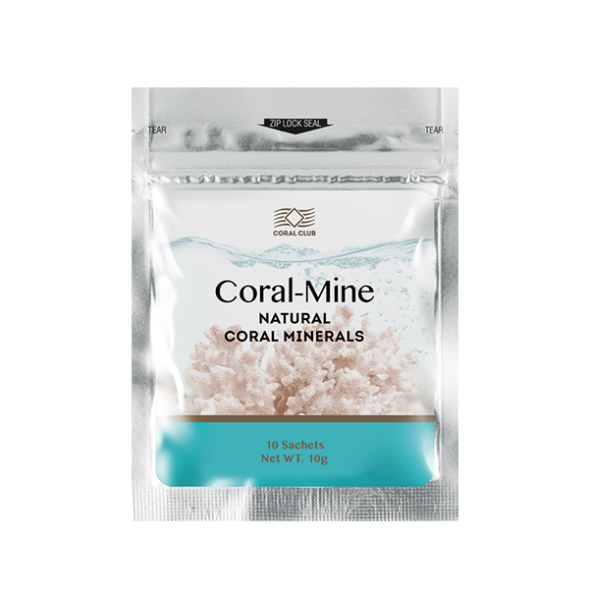
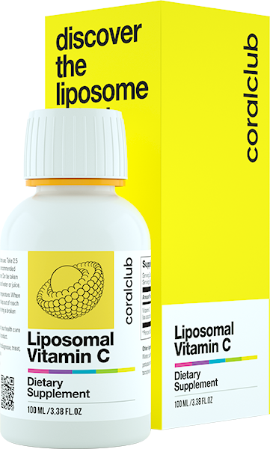
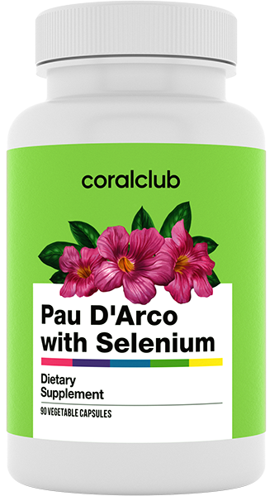
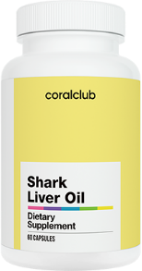
Immunity pack
Liposomal Vitamin C
D-Spray 2000
Paul D'arco with Selenium
Shark Liver Oil
Coral-Mine

Slide 14
Liposomal Vitamin C
Features
Provides support for the immune system
Provides protection from free radical damage
Assists in collagen production – a key protein in our bodies, particularly for the skin
Protects the body from negative environmental effects
Excellent source of the antioxidant vitamin C
These statements have not been evaluated by the Food and Drug Administration. This product is not intended to diagnose, treat, cure, or prevent any disease
Notes:
Epidemiological studies show that vitamin C deficiency is still relatively common and vitamin C deficiency is the fourth leading nutritional deficiency in United Nations members. Reasons: a decrease in consumption of the vitamin from food, combined with a limited ability to form a reserve in the body (this is a water-soluble vitamin, it is not retained in tissues; it is impossible to keep in reserve).
Increased demand for vitamin C is caused by environmental pollution, smoking, fighting infections, as well as diseases with oxidative and inflammatory manifestations, such as type 2 diabetes, etc.
Vegetarians will be interested to know that vitamin C helps the body better absorb non-hemic iron - from plant-based foods such as beans, spinach and quinoa.

Slide 15
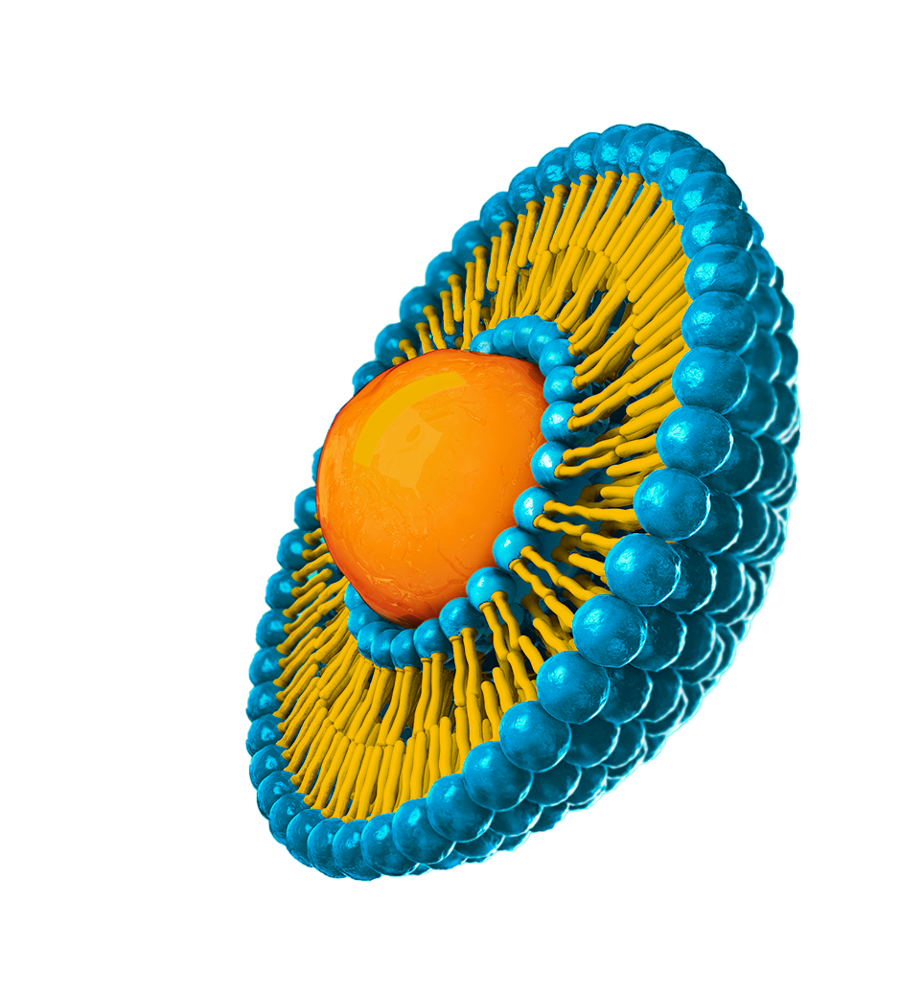
Benefits of
the liposomal form of vitamins
The liposomal products have high concentrations of the key ingredients
The liposomal membrane protects the ingredients and prevents gastrointestinal irritation.
The liposomal membrane is also an additional source of phospholipids that help protect the cell membrane
Liposome act as a delivery vehicle for substances to make their way into the body, while preventing premature breakdown in stomach acid

Slide 16
D-SpRay 2000
Features
Provides support to our adaptive immune system, including T- and B-cells
Supports antibacterial and antiviral defenses
Helps prevent Vitamin D deficiency. This deficiency may increase the risk of developing autoimmune diseases.
Notes:
For a long time, it was believed that the main function of vitamin D in the body is to regulate the absorption of phosphorus and calcium in the bones. But recently, vitamin D receptors have been discovered in many other tissues in our body. And now scientists claim that "this vitamin is involved in the regulation of the immune and cardiovascular systems, and the development of muscles" (Anthony Norman, professor emeritus of biochemistry and biomedicine at the University of California and one of the world's leading experts on vitamin D). The researchers found that T cells rely primarily on vitamin D to activate, but if there is not enough vitamin D in the blood, they will remain dormant. "When a T cell comes in contact with a virus or bacterium, it turns into a signaling device known as a vitamin D receptor that looks for the vitamin throughout the body," says Carsten Geisler, a specialist in the Department of International Health, Immunology and Microbiology. "This means that T cells must be fed with vitamin D, otherwise they will stop working. If T cells cannot find enough vitamin D in the body, then they will not even start fighting."

Slide 17
Pau D'arco with selenium
Pau D'arco contains Pau D’arco tree bark,
Selenium and Vitamin C. These have an array of effects.
Pau D’arco:
Helps fight bacteria and fungi.
May help stimulate immune cell activity
Helps prevent oxidative stress
Selenium:
Participates in the synthesis of immune cells
Helps normalize oxidative levels
Provides immune support
Notes:
17

Slide 18
Shark Liver Oil
Provides cellular support
Helps protect against oxidative stress
Promotes healthy skin
Supports the local and systematic immune response (IgG and IgA immunoglobulins)

Slide 19
Coral-Mine
Coral-Mine is a composition made from corals harvested near the Japanese island of Okinawa. This island is also called the “Island of the Immortals” due to the longevity of the residents.
Enriches water with minerals
Provides immune system support
Promotes better hydration
Helps with signs of aging
Promotes skin health
Helps restore water-salt balance
Helps to support healthy blood pressure levels
These statements have not been evaluated by the Food and Drug Administration. This product is not intended to diagnose, treat, cure, or prevent any disease

Slide 20
Immunity pack
BONUS POINTS
MEMBER PRICE
RETAIL PRICE

Slide 21
Concept of health
A holistic approach to overall health improvement.
A series of easy to follow stages
Maintains usual lifestyle
Helps restore health and well-being

Slide 22
Immunity Pack
MAXIMUM IMMUNITY PROTECTION

