Slide 1
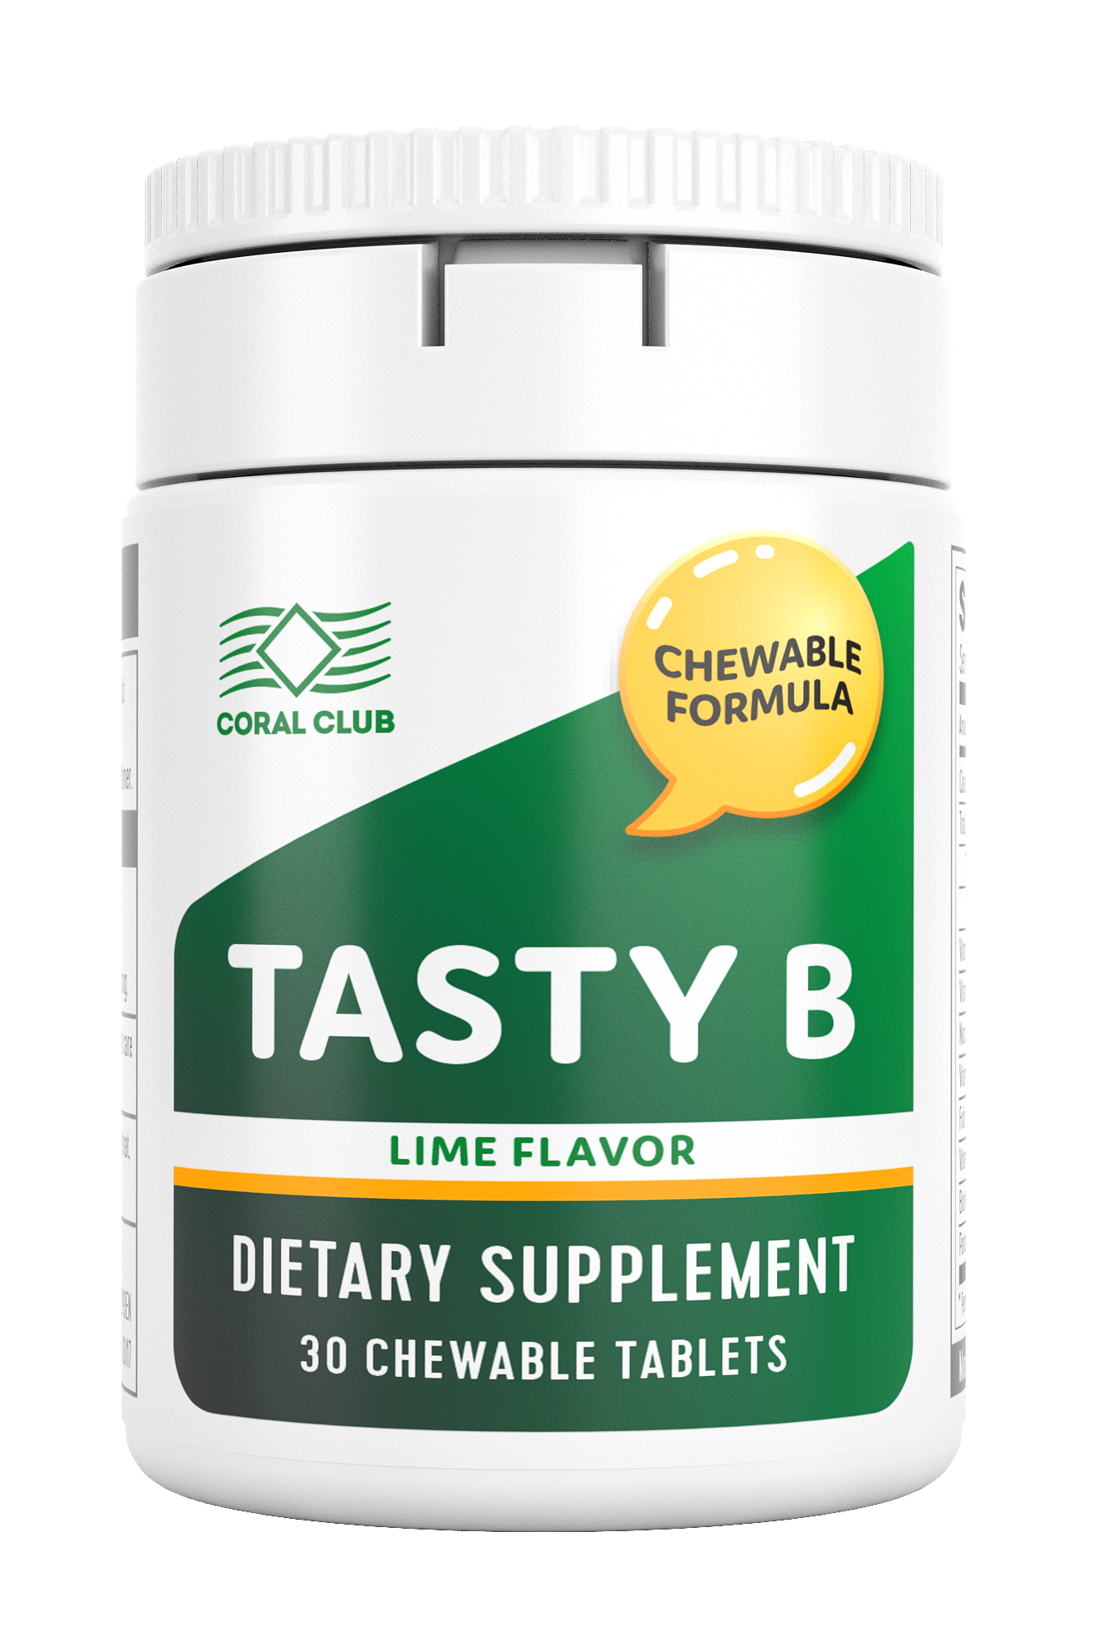

TASTY B
Chewable tablets with B-Complex vitamins and a pronounced lime flavor
CORAL-CLUB.COM

Slide 2
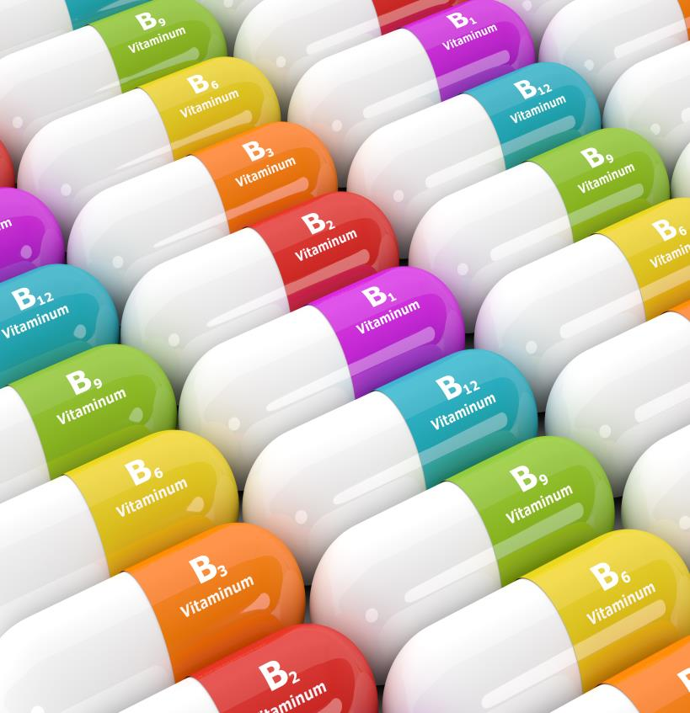
Vitamins are essential for the proper functioning of our organism.
The name “vitamin” was created with the discovery of thiamine (vitamin B1).
Notes:
The B-vitamin complex is actually diverse in its makeup and function. This group includes B1, B2, B3, B5, B6, B7, B9 and B12 vitamins.
Vitamins B help to support the nervous system and they are responsible for maintaining overall health. They play an important role in the growth, recovery and proper functioning of the body.
The word VITAMIN is a combination of the Latin word “vita” (meaning life) and “amine” meaning nitrogen-based compounds.
*www.etymonline.com/index.php?term=vitamin

Slide 3

Vitamin B1 was discovered in 1897 by Dutch physician and pathologist Christiaan Eijkman, who was researching the causes of beriberi, a common disorder with symptoms of fatigue, weakness and heart failure.*
The cause of this health problem was determined to be a deficiency of Vitamin B1 (Thiamine).
Notes:
In 1929, Eijkman shared the Nobel Prize in Physiology or Medicine with Frederick Hopkins.
Eijkman found that instances of beriberi were related to diet. People in southeast Asia who consumed polished rice, suffered from beriberi at a higher rate than those who consumed unpolished rice. He reasoned that the skin of the rice contained an important substance, which prevented beriberi. This substance later came to be known as vitamin B1.*
*https://www.nobelprize.org/educational/medicine/vitamin_b1/eijkman.html

Slide 4
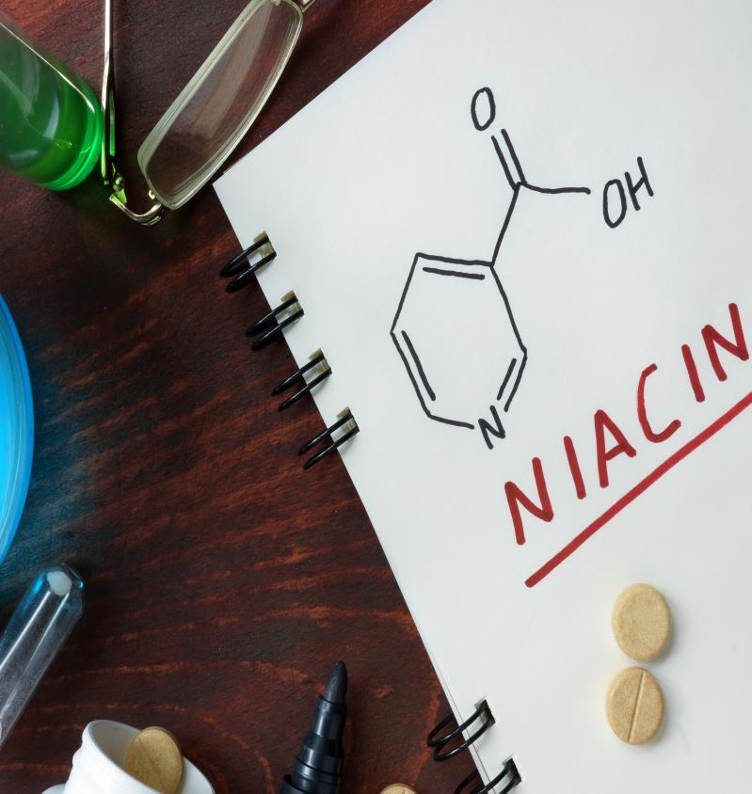
Vitamin B3 helped to prevent another health problem – Pellagra.*
Vitamin B3 is also known as vitamin PP (pellagra preventing).
Notes:
Pellagra is another health problem associated with niacin (vitamin B3) deficiency.
The condition quickly became associated with maize-based diets.
The symptoms of pellagra are the following: swelling of mucous membranes; scaly sores on skin; diarrhea; headaches and insomnia; extreme sensitivity to sunlight and to loud music. In the later stages, patients begin to exhibit neurological problems.
Pellagra was considered to be an infectious disease until the early 20th century, when scientists succeeded in proving that nutritional deficiency (poor in niacin) was a cause of pellagra. Niacin was the third of the B complex vitamins to be identified as Vitamin B3, also known as vitamin PP (pellagra preventing).
*http://www.who.int/nutrition/publications/en/pellagra_prevention_control.pdf

Slide 5






BERIBERI AND PELLAGRA ARE OCCASIONALLY SEEN IN THE MODERN WORLD,
WHICH MEANS THAT SOME PEOPLE STILL EXPERIENCE A DEFICIENCY OF
B COMPLEX VITAMINS IN THE BODY.
Symptoms : chronic fatigue, mood swings, apathy, low energy level, hypotension, insomnia, skin disorders.
Notes:
Today vitamin deficiencies still occur in many countries.
Symptoms of B group vitamins deficiency:*
Chronic fatigue
Emotional disturbances and apathy
Low energy levels
Skin and hair problems
Insomnia
Each B vitamin is essential to certain bodily functions.
For example, deficiency of Thiamine (Vitamin B1) can lead to a fast heart beat and shortness of breath. Riboflavin (Vitamin B2) is important for prevention of eye problems and supports hemoglobin levels.

Slide 6

What are the reasons?
Notes:
Why is there still a deficiency of B group vitamins in the modern world?
It’s would seems that we should be able to get all the necessary vitamins from food we eat…

Slide 7
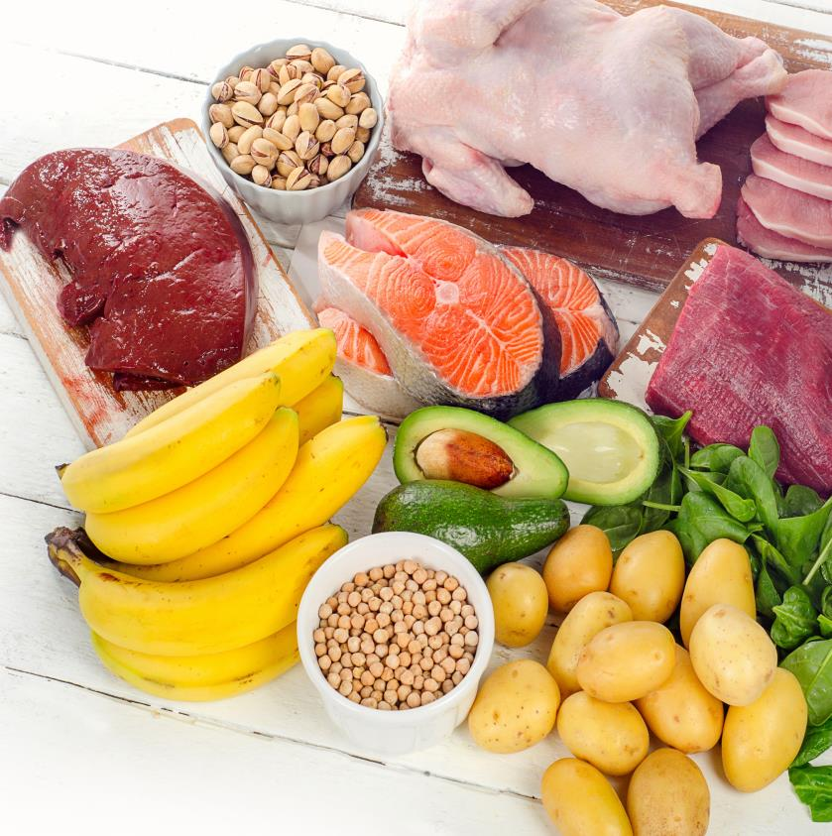
Where B complex vitamins are found:*
Beans and enriched grain products;
Potatoes;
Nuts;
Liver, eggs, beef, poultry;
Cheese and dairy product;
Fish;
Cereals;
Green leafy vegetables.
Notes:
The B complex vitamins are found in a variety of foods: cereal grains, meat, poultry, eggs, fish, milk and fresh vegetables.
If you eat these foods in your daily diet, you, probably, get enough B group vitamins.
Unfortunately, not everyone is able to ensure proper nutrition (for a variety of reasons).
*https://www.accessdata.fda.gov/scripts/InteractiveNutritionFactsLabel/factsheets/Vitamin_and_Mineral_Chart.pdf

Slide 8

Today’s meal:
tasty but useless
Processed food and alcohol easily destroy B vitamins in the organism
Notes:
Unfortunately, majority of people prefer processed products rich in carbohydrates: white flours, breads, rice and sweets.
Processed foods are often cheaper and more tasty than fresh foods, that’s why people buy inexpensive food that is widely available. That will lead to many health issues including deficiency of B complex vitamins.
We often eat processed and refined foods and much less fresh vegetables and fruits, because it’s easy to get fooled by packaged foods that sound more nutritious than they actually are.

Slide 9




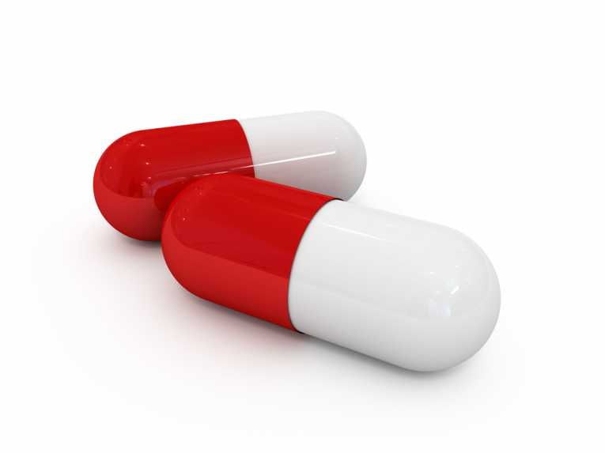


There are other reasons. В complex vitamins are:
water soluble and delicate
easily destroyed during the cooking process
easily destroyed by caffeine
some drugs can lead to B vitamins deficiency
necessary to boost energy after strenuous physical activity
easily destroyed when combined with alcohol or cigarettes
Notes:
B complex vitamins are water-soluble vitamins that are not stored in the body and must be replaced each day.
All the B vitamins are sensitive to heat, but thiamin, also known as vitamin B-1, and folic acid, or vitamin B-12, are the most unstable and likely to be destroyed by cooking and improper storage.*
Alcohol, caffeine and cigarettes can destroy your daily intake of B vitamins.
If you are consuming antibiotics, contraceptives, diuretics or other medications, this can lead to vitamin deficiency in the body and unwanted side effects.
*https://www.dsm.com/content/dam/dsm/nip/en_US/documents/stability.pdf

Slide 10


We need B complex vitamins every day.
B vitamins are mostly important:
for athletes and active individuals;
when dealing with stress;
for people who drink coffee and energy drinks;
for people who smoke and drink alcohol.
Notes:
Nowadays, our lifestyle has an influence on B complex vitamins deficiency in the body.
For example, during the day you are working in the office (coffee keeps you alert), in the evening you go to the gym.
Another popular way to relax is alcohol and cigarettes.

Slide 11

That’s the reason why you feel tired all the time.
The body has a B complex vitamins deficiency .

Slide 12

What to do?
TASTY B –
THE RIGHT CHOICE!
Notes:
Tasty B will help you to avoid B vitamins deficiency in the organism.

Slide 13
TASTY B
Chewable tablets with a balanced set of B-Complex vitamins and a pronounced lime flavor!
Helps to normalize nervous system function;
Energy storage;
Helps with red blood cell formation;
Benefits for skin, hair and nails.
1 bottle = 30 chewable tablets

Slide 14
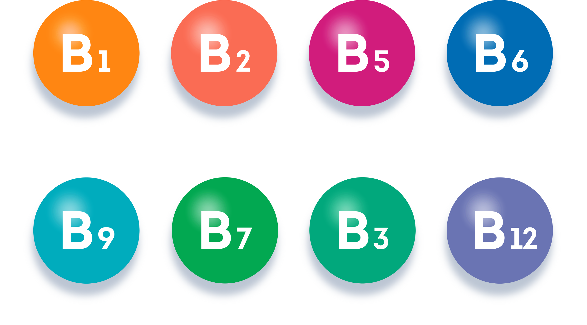






TASTY B CONTAINS B GROUP VITAMINS:
В1, В2, В3, В5, В6, В7, В9, В12
Notes:
Vitamin В1 (thiamine) plays a vital role in cell metabolism, in digestion of proteins, fats and carbohydrates. Thiamine helps to prevent complications in the nervous system: improves performance and memory, helps to prevent brain aging, and helps with mood swings.*
Vitamin В2 (riboflavin) plays a crucial role in metabolism of nutrients, and in the production of energy, which fuels the body (Adenosine triphosphate - ATP). Riboflavin is important for eye health; helps to detoxify the liver; plays an important role in protecting the nervous system, responsible for maintaining healthy blood cells.**
Vitamin В3 (niacin) maintains the metabolism and provides energy, helps to reduce cholesterol levels, which prevents the thickening of artery walls and conditions like atherosclerosis. Niacin helps to improve mental health.***
Vitamin В5 (pantothenic acid) serves its role in the brain promoting the CNS, helps to boost the immune system. This vitamin helps to increase the stamina of the body.****
Vitamin В6 (pyridoxine) helps to maintain health of the nervous and cardiovascular systems )together with Vitamins B9 and B12). Promotes protein, carbohydrate, and fat metabolism.****
Vitamin В7 (biotin, « the vitamin of youth and beauty ») helps maintain sufficient levels of keratin in the body, improves the condition of the hair and skin, prevents premature hair loss, and strengthens the structure of the nails, stopping them from splitting and peeling, restores the function of the sebaceous glands, affecting fat content in skin cells, including those of the scalp.****
Vitamin В9 (folic acid) one of the most important functions of Vitamin B9 is in the cardiovascular system, hemoglobin synthesis and red blood cell formation. It is also required for the synthesis of nucleic acids, which contain heritable genes. Folic acid plays an important role in reproduction, increasing the synthesis of the female sex hormones estrogen and progesterone, improves ovarian function.****
Vitamin В12 (cyanocobalamine) boosts mood and helps the CNS to properly function, helps to prevent anemia and maintain energy levels, used to lower the risk of memory loss.*****
*https://medlineplus.gov/ency/article/002401.htm
**http://www.jpsr.pharmainfo.in/Documents/Volumes/Vol6Issue08/jpsr06081406.pdf
***https://medlineplus.gov/druginfo/natural/924.html
****https://www.accessdata.fda.gov/scripts/InteractiveNutritionFactsLabel/factsheets/Vitamin_and_Mineral_Chart.pdf
*****http://www.jpsr.pharmainfo.in/Documents/Volumes/vol6issue03/jpsr06031401B.pdf

Slide 15

Natural Lime Flavor in Tasty B
Notes:
No artificial flavors – only natural lime flavor.

Slide 16

TASTY B CONTAINS NATURAL FLAVORING
STEVIOL GLYCOSIDES (Stevia leaves)
Notes:
Tasty B contains natural flavoring of steviol glycosides - the natural sweetener of the plant Stevia.
*https://www.fda.gov/downloads/Food/IngredientsPackagingLabeling/GRAS/NoticeInventory/ucm337462.pdf

Slide 17

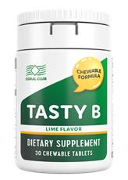
TASTY B –
A DELICIOUS WAY TO BOOST VITAMIN INTAKE
CORAL-CLUB.COM
Notes:
You can take Tasty B chewable tablets any time, no need for water.
These chewable tablets have a nice taste of fresh citrus.

Slide 18
Balanced B complex vitamins:
В_{1,} В_{2,} В_{3,} В_{5,} В_{6,} В_{7,} В_{9,} В₁₂
Easy to take
1 chewable tablet once a day.
Nice flavor
Natural flavoring - steviol glycosides
Affordable price!
Tasty B: the right choice!

Slide 19
TASTY B
Chewable tablets with balanced
B-Complex vitamins and a pronounced lime flavor!
Source of B group vitamins
Natural flavor
Affordable price

Slide 20
$8.75 USD. Retail price
$7.00 USD. Member price
4.5 Volume Points
CORAL-CLUB.COM
Notes:
Tasty B:
VP ХХ
MP ХХ
RP ХХ

